Slide 1
Transformers Ch 16
Dr. Malak Abdullah
Computer Science Department
Jordan University of Science and Technology

Slide 2
NLP - Word embedding
Most of the state-of-the-art NLP applications, such as machine translation, automatic summarization, parsing, sentiment analysis, and more, are now based (at least in part) on RNNs.
Word embeddings provide a dense representation of words and their relative meanings
Word embeddings can be learned from text data and reused among projects. They can also be learned as part of fitting a neural network on text data.
It is an improvement over the traditional bag-of-word model encoding schemes where large sparse vectors were used to represent each word or to score each word within a vector to represent an entire vocabulary. These representations were sparse because the vocabularies were vast and a given word or document would be represented by a large vector comprised mostly of zero values.
Instead, in an embedding, words are represented by dense vectors where a vector represents the projection of the word into a continuous vector space.
The position of a word within the vector space is learned from text and is based on the words that surround the word when it is used.

Slide 3
Word-Embedding
The most common solution is to represent each word in the vocabulary using a fairly small and dense vector (e.g., 150 dimensions), called an embedding, and just let the neural network learn a good embedding for each word during training.
At the beginning of training, embeddings are simply chosen randomly, but during training, backpropagation automatically moves the embeddings around in a way that helps the neural network perform its task.
Typically this means that similar words will gradually cluster close to one another, and even end up organized in a rather meaningful way.
For example, embeddings may end up placed along various axes that represent gender, singular/plural, adjective/noun, and so on.

Slide 4
Word embeddings
Two popular examples of methods of learning word embeddings from text include:
Word2Vec
GloVe
Keras offers an Embedding layer that can be used for neural networks on text data.

Slide 5
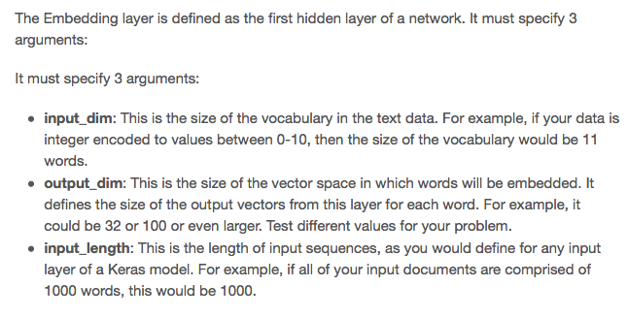
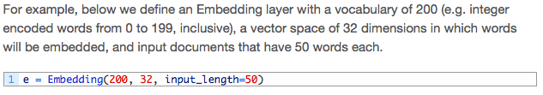
The embedding layer

Slide 6
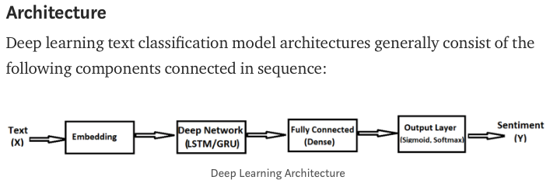
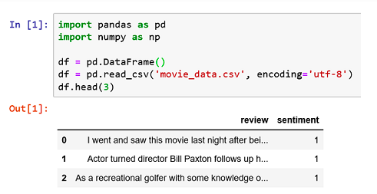
Example: Sentiment analysis

Slide 7
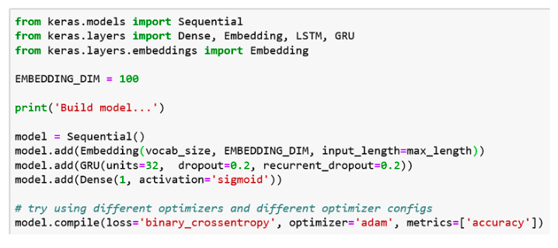
Continue
Your model will use an Embedding layer as the first hidden layer. The Embedding layer is initialized with random weights and will learn an embedding for all of the words in the training dataset during training of the model.

Slide 8
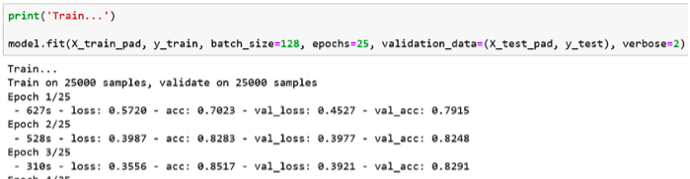
You can find the rest of the example
https://towardsdatascience.com/machine-learning-word-embedding-sentiment-classification-using-keras-b83c28087456

Slide 9
Encoder-Decoder
It was initially developed for machine translation problems, although it has proven successful at related sequence-to-sequence prediction problems such as text summarization and question answering.
Following are some of the application of sequence to sequence models:
Chatbots
Machine Translation
Text summary
Image captioning

Slide 10
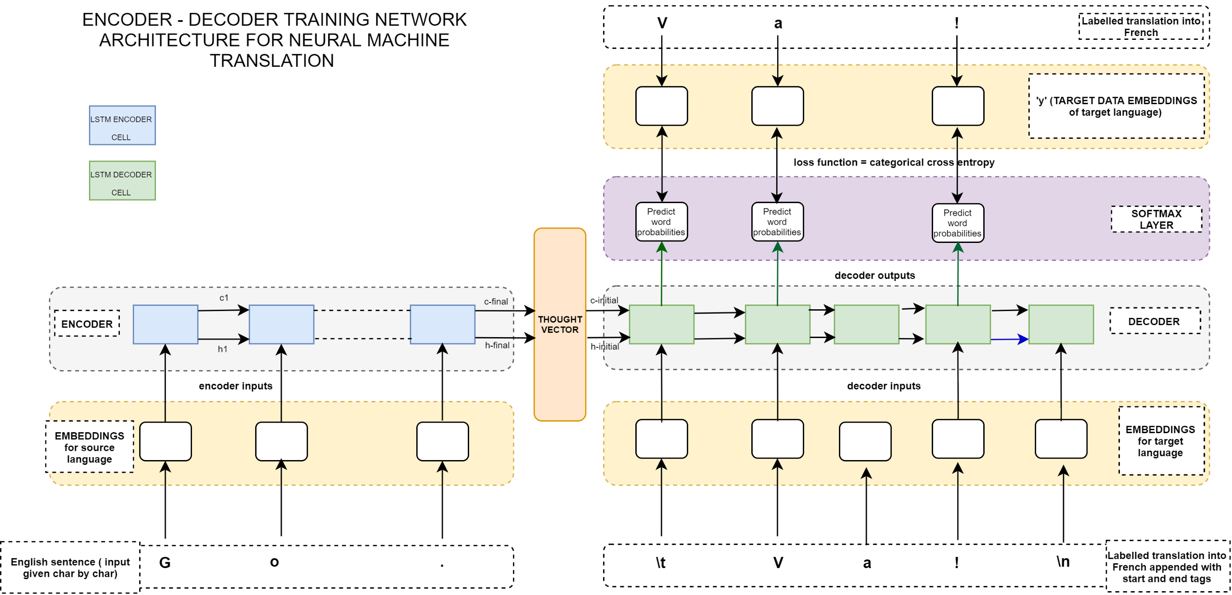
An Encoder–Decoder Network for Neural Machine Translation
Encoder: The encoder is responsible for stepping through the input time steps and encoding the entire sequence into a fixed length vector called a context vector.
Decoder: The decoder is responsible for stepping through the output time steps while reading from the context vector.

Slide 11
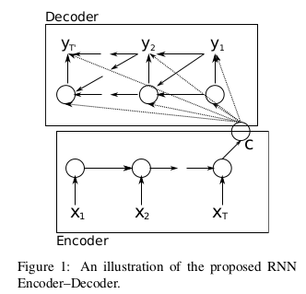
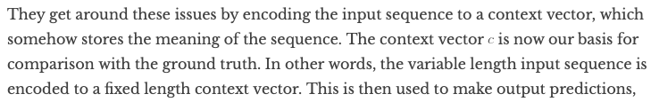
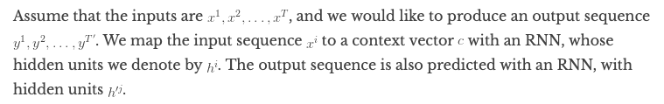
Why not word to word?
The input and output sequences are of varying lengths
The ordering is not one-to-one or in order [black cat == chat noir].

Slide 12
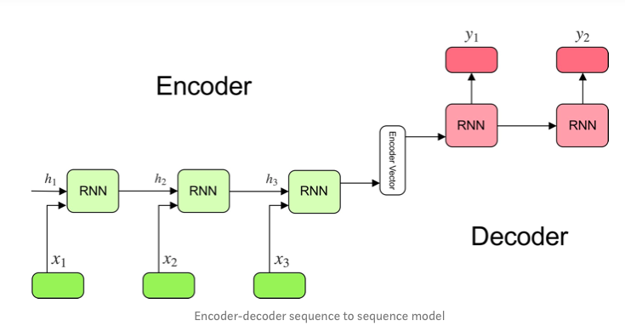
The model consists of 3 parts: encoder, intermediate (encoder) vector and decoder.

Slide 13
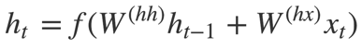
Encoder
A stack of several recurrent units (LSTM or GRU cells for better performance) where each accepts a single element of the input sequence, collects information for that element and propagates it forward.
In question-answering problem, the input sequence is a collection of all words from the question. Each word is represented as x_i where i is the order of that word.
The hidden states h_i are computed using the formula:
This simple formula represents the result of an ordinary recurrent neural network. As you can see, we just apply the appropriate weights to the previous hidden state h_(t-1) and the input vector x_t.
Outputs of the encoder are rejected and only internal states are used.

Slide 14
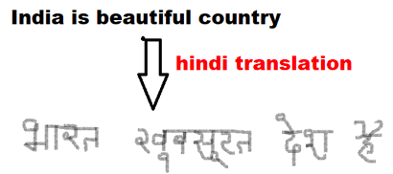
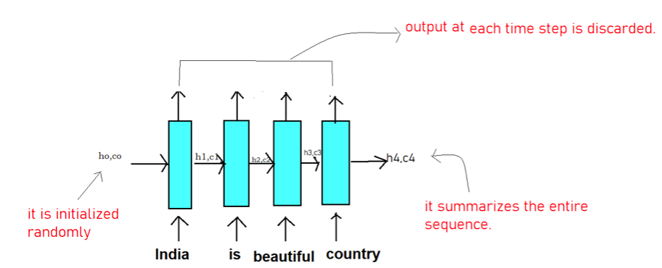
Encoder Example
Consider the English sentence- India is beautiful country. This sequence can be thought of as a sentence containing 4 words (India, is, beautiful, country). So here
X1 =’India’ X2=’is’ X3= ‘beautiful’ X4=’country’.
Therefore LSTM will read this sequence word by word in 4-time step as follows:
the LSTM has read until time step t. For e.g when t=2, it remembers that LSTM has read ‘India is ‘.
The initial states ho, co(both are vectors) is initialized randomly or with zeroes.
Remember the dimension of ho, co is same as the number of units in LSTM cell.
The final state h4,c4 contains the crux of the entire input sequence India is beautiful country.

Slide 15
Encoder Vector
This is the final hidden state produced from the encoder part of the model. It is calculated using the previous formula.
This vector aims to encapsulate the information for all input elements in order to help the decoder make accurate predictions.
It acts as the initial hidden state of the decoder part of the model

Slide 16
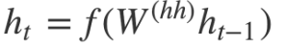
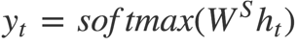
Decoder
A stack of several recurrent units where each predicts an output y_t at a time step t.
Each recurrent unit accepts a hidden state from the previous unit and produces an output as well as its own hidden state.
In the question-answering problem, the output sequence is a collection of all words from the answer. Each word is represented as y_i where i is the order of that word.
Any hidden state h_i is computed using the formula:
As you can see, we are just using the previous hidden state to compute the next one.
The output y_t at time step t is computed using the formula:
We calculate the outputs using the hidden state at the current time step together with the respective weight W(S). Softmax is used to create a probability vector which will help us determine the final output (e.g. word in the question-answering problem).
The power of this model lies in the fact that it can map sequences of different lengths to each other. As you can see the inputs and outputs are not correlated and their lengths can differ. This opens a whole new range of problems which can now be solved using such architecture.

Slide 17
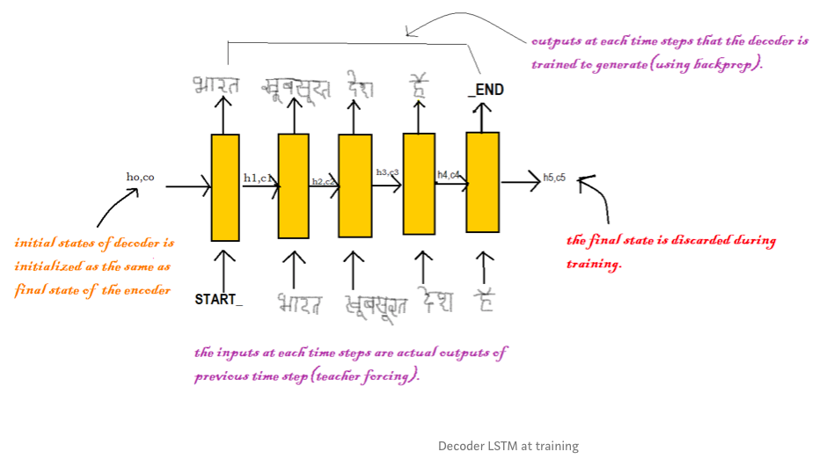
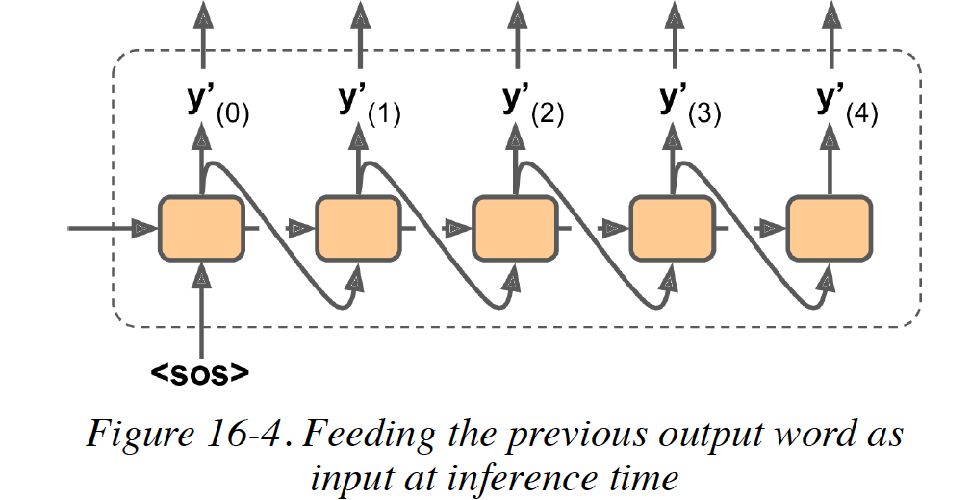
The working of the decoder is different during the training and testing phase unlike the encoder part of the model which works in the same fashion in training and test phase.
For the decoder to recognize the starting and end of the sequence, we will add START_ at the beginning of the output sequence and _END at the end of the output sequence.
you will not have the target sentence to feed to the decoder. Instead, simply feed the decoder the word that it output at the previous step

Slide 18
The initial states (ho, co) of the decoder is set to the final states of the encoder. It can be thought of as that the decoder is trained to generate the output based on the information gathered by the encoder.
Firstly, we input the START_ so that the decoder starts generating the next word. And after the last word in the Hindi sentence, we make the decoder learn to predict the _END.
Here we use the teacher forcing technique where the input at each time step is actual output and not the predicted output from the last time step.
At last, the loss is calculated on the predicted outputs from each time step and the errors are backpropagated through time to update the parameters of the model.
The final states of the decoder are discarded as we got the output hence it is of no use.

Slide 19
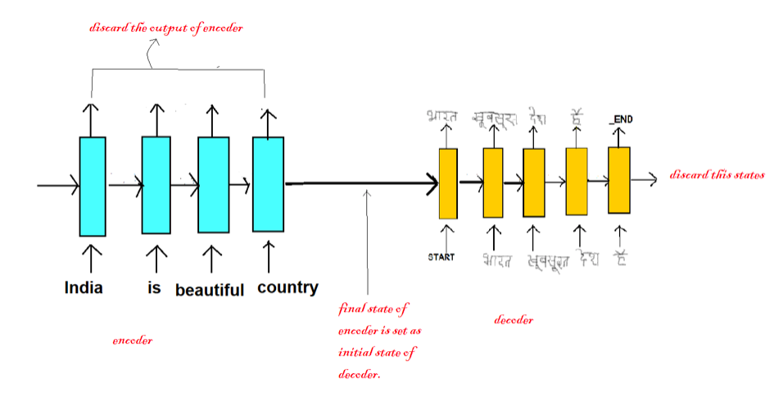

Slide 20
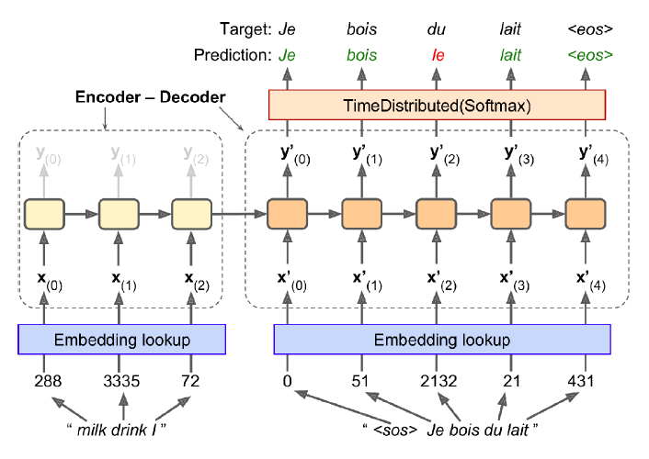
Example: Translate English sentences to French
The English sentences are fed to the encoder, and the decoder outputs the French translations.
Note that the French translations are also used as inputs to the decoder, but shifted back by one step.
For the very first word, it is given the start-of-sequence (SOS) token.
The decoder is expected to end the sentence with an end-of-sequence (EOS) token.
Note that the English sentences are reversed before they are fed to the encoder.
This ensures that the beginning of the English sentence will be fed last to the encoder, which is useful because that’s generally the first thing that the decoder needs to translate.

Slide 21
The encoder-decoder recurrent neural network architecture is the core technology inside Google’s translate service.
At each step, the decoder outputs a score for each word in the output vocabulary (i.e., French), and then the softmax layer turns these scores into probabilities. For example, at the first step the word “Je” may have a probability of 20%, “Tu” may have a probability of 1%, and so on.
The word with the highest probability is output. This is very much like a regular classification task, so you can train the model using the "sparse_categorical_crossentropy" loss, much like we did in the Char-RNN model.
Translating “What are you doing today?” from English to Chinese has input of 5 words and output of 7 symbols (今天你在做什麼？).
Clearly, we can’t use a regular LSTM network to map each word from the English sentence to the Chinese sentence.

Slide 22
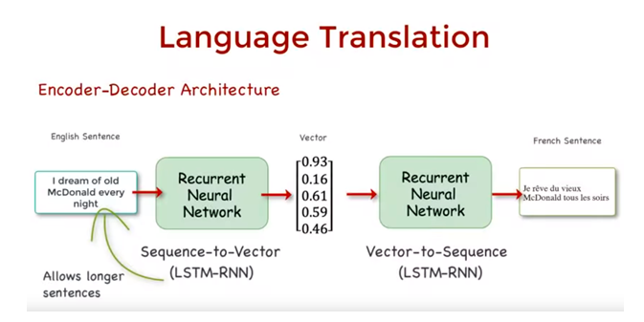
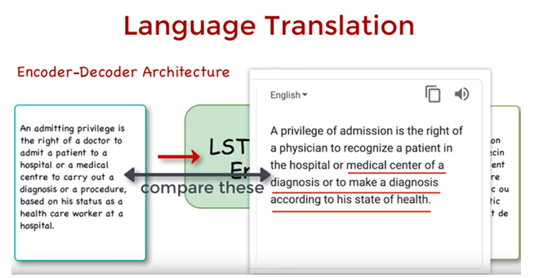
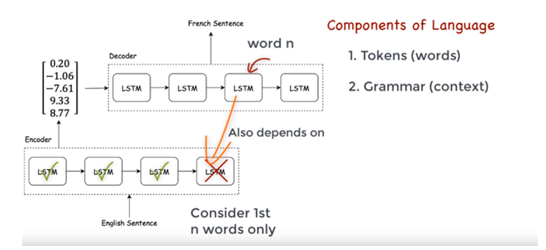
The problem
This encoder-decoder architecture, breaks down after about 20+ word sentences:
Why? Longer sentences illustrate the limitations of a single-directional encoder-decoder architecture.
Because language consists of tokens and grammar, the problem with this model is it does not entirely address the complexity of the grammar.
Specifically, when translating the nth word in the source language, the RNN was considering only the 1st n-word in the source sentence, but grammatically, the meaning of a word depends on both the sequence of words before and after it in a sentence
A solution: The bi-directional LSTM model

Slide 23
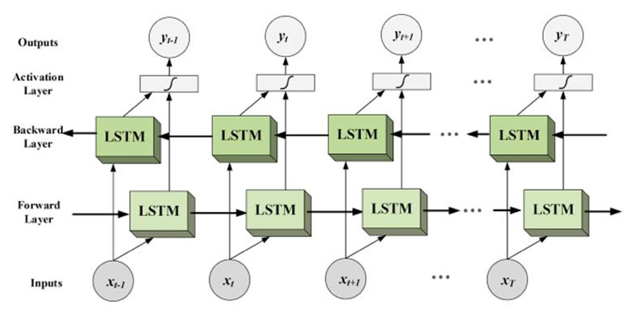
Bi-LSTM
Bidirectional LSTMs are an extension to typical LSTMs that can enhance performance of the model on sequence classification problems. Where all time steps of the input sequence are available, Bi-LSTMs train two LSTMs instead of one LSTMs on the input sequence.
The first on the input sequence as-is and the other on a reversed copy of the input sequence. By this additional context is added to network and results are faster.

Slide 24
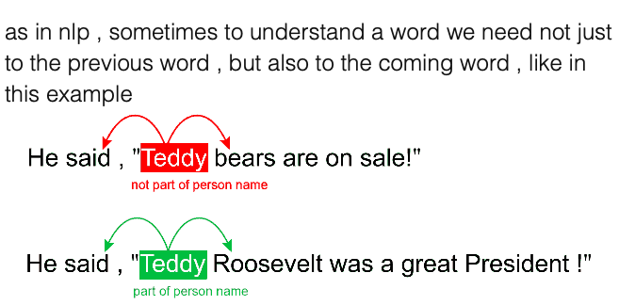
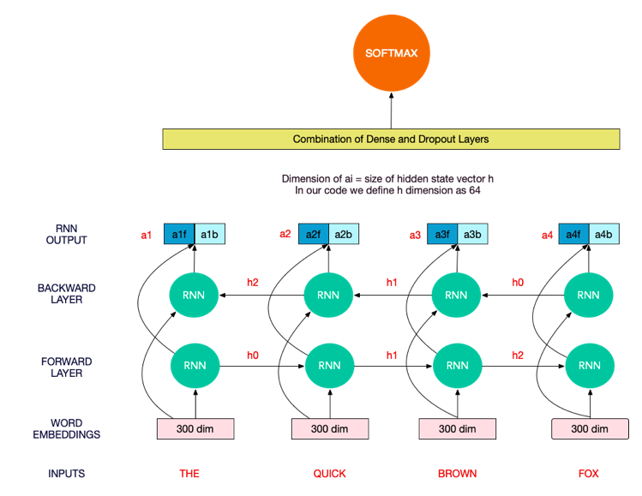

Slide 25
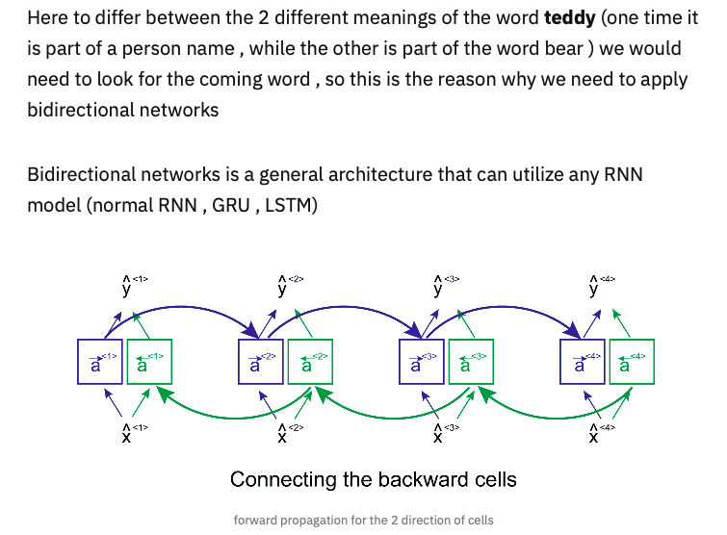

Slide 26
The idea behind Bidirectional Recurrent Neural Networks (RNNs)
replicating the first recurrent layer in the network then providing the input sequence as input to the first layer and providing a reversed copy of the input sequence to the replicated layer.
This overcomes the limitations of a traditional RNN.
Bidirectional recurrent neural network (BRNN) can be trained using all available input info in the past and future of a particular time-step.
Split of state neurons in regular RNN is responsible for the forward states (positive time direction) and a part for the backward states (negative time direction).
In the speech recognition domain the context of the whole utterance is used to interpret what is being said rather than a linear interpretation thus the input sequence is feeded bi-directionally. To be precise, time steps in the input sequence are processed one at a time, but the network steps through the sequence in both directions same time.

Slide 27
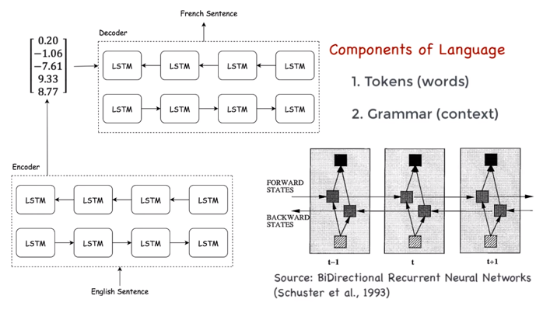
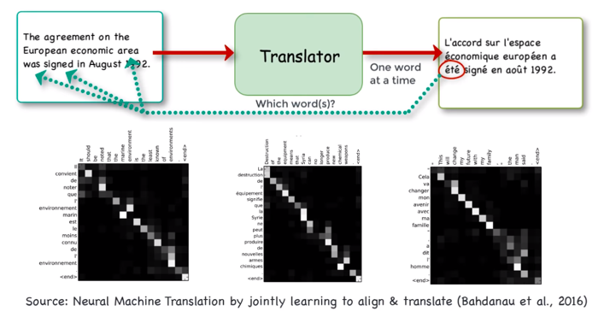
If we use a bi-directional model, it allows us to input the context of both past and future words to create an accurate encoder output vector
The challenge then becomes, which word do we need to focus on in a sequence?
In 2016, Bahdanau et. al. came out with a paper that shows we can learn which words in the source language to focus on by storing the previous outputs of the LSTM cells, then ranking them by the relevancy of each, and picking the word with the highest score

Slide 28
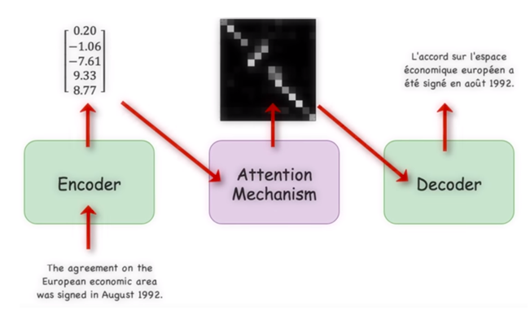
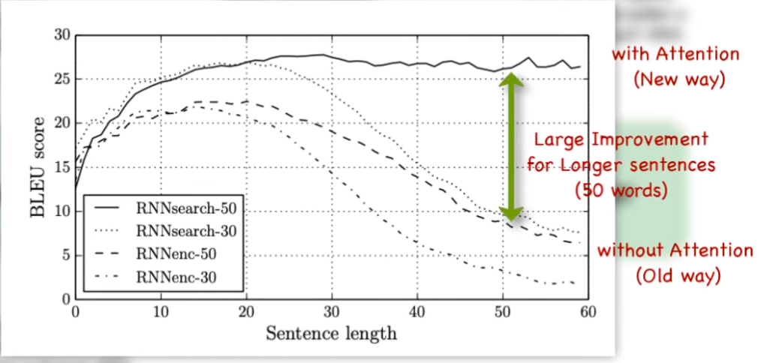
you can see how this looks in the graphs: the resulting architecture then embeds this Attention mechanism in between the Encoder and Decoder
So the encoder takes each word in the source language and encodes it into vector space
These vector representations of words are then passed into an attention mechanism which determines which source words to focus on while generating some output for the desired language.
This output is passed through a decoder that turns the vector representations into the target language

Slide 29
Attention
When we think about the English word “Attention”, we know that it means directing your focus at something and taking greater notice.
2014 has introduced a technique that allowed the decoder to focus on the appropriate words (as encoded by the encoder) at each time step.
The Attention mechanism in Deep Learning is based off this concept of directing your focus, and it pays greater attention to certain factors when processing the data.
In broad terms, Attention is one component of a network’s architecture, and is in charge of managing and quantifying the interdependence:
Between the input and output elements (General Attention)
Within the input elements (Self-Attention)

Slide 30
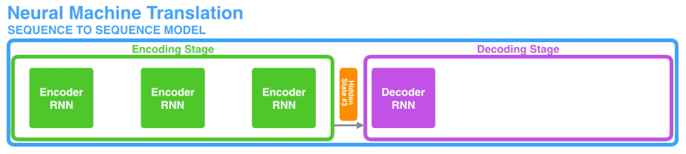
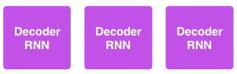
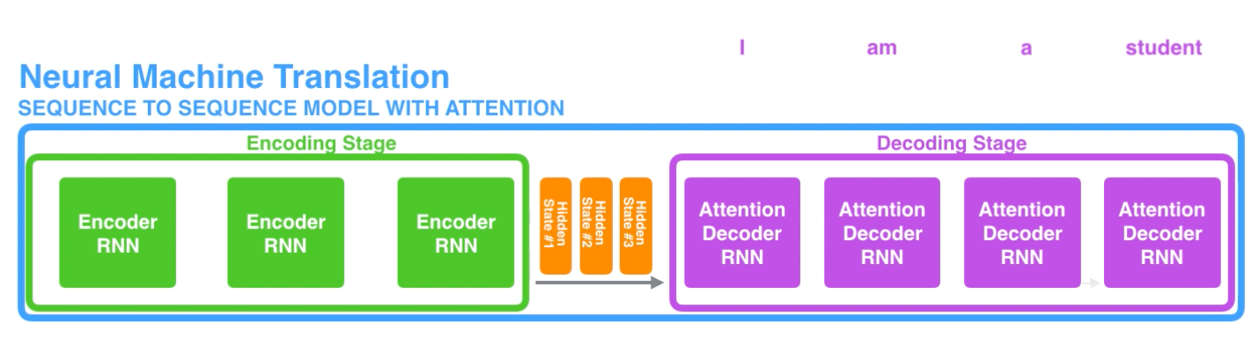
Instead of passing the last hidden state of the encoding stage, the encoder passes all the hidden states to the decoder
https://jalammar.github.io/visualizing-neural-machine-translation-mechanics-of-seq2seq-models-with-attention/

Slide 31
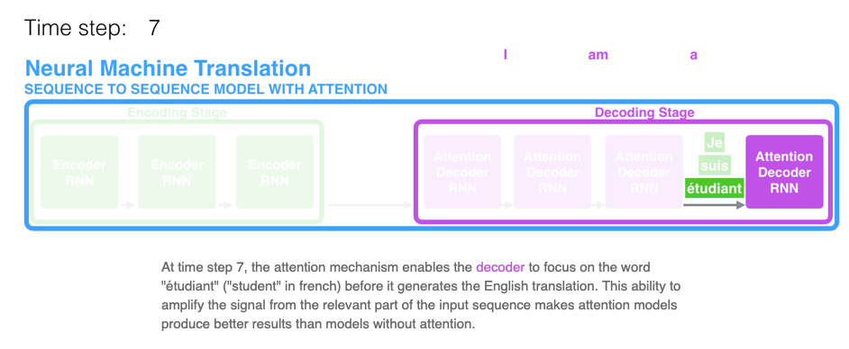
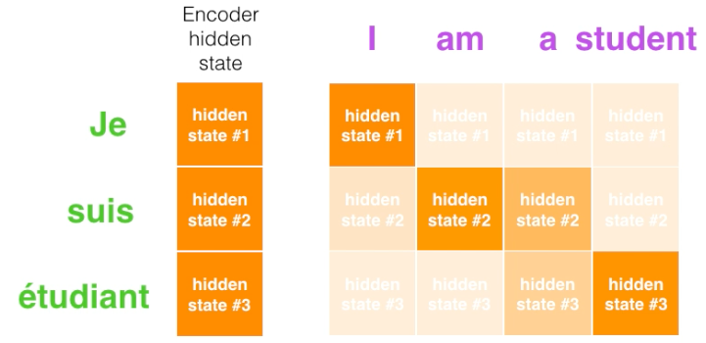
https://jalammar.github.io/visualizing-neural-machine-translation-mechanics-of-seq2seq-models-with-attention/

Slide 32
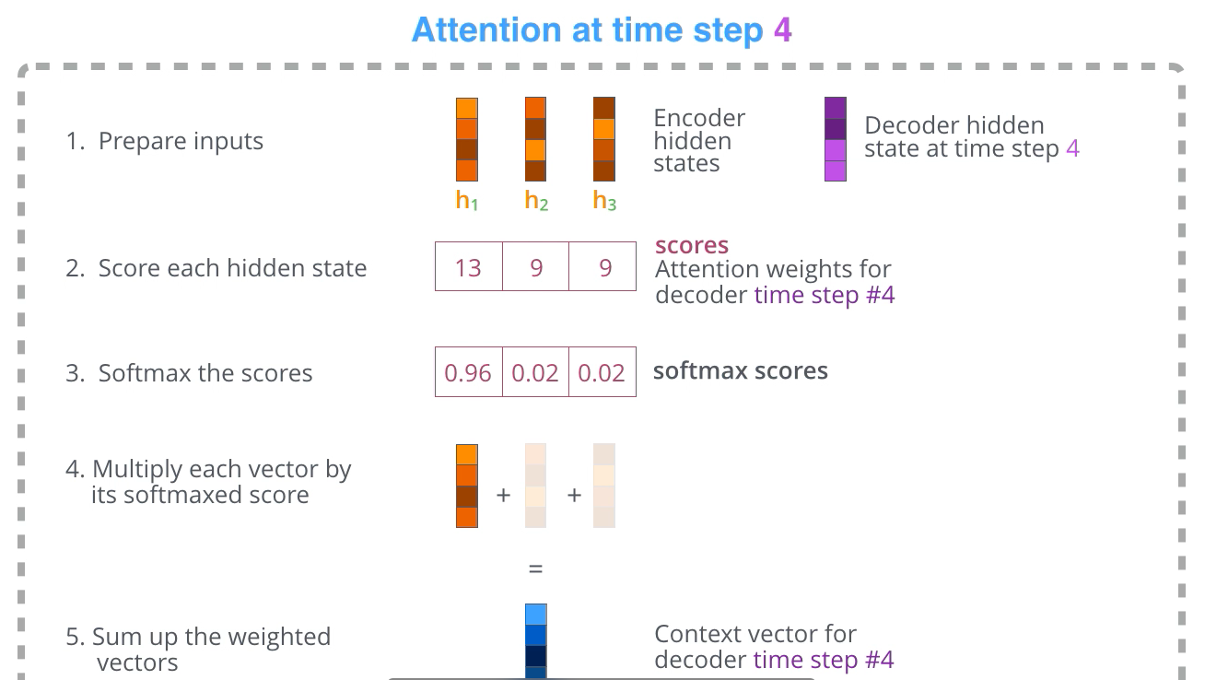
An attention decoder does an extra step before producing its output. In order to focus on the parts of the input that are relevant to this decoding time step, the decoder does the following:
Look at the set of encoder hidden states it received – each encoder hidden states is most associated with a certain word in the input sentence
Give each hidden states a score (let’s ignore how the scoring is done for now)
Multiply each hidden states by its softmaxed score, thus amplifying hidden states with high scores, and drowning out hidden states with low scores
https://jalammar.github.io/visualizing-neural-machine-translation-mechanics-of-seq2seq-models-with-attention/

Slide 33
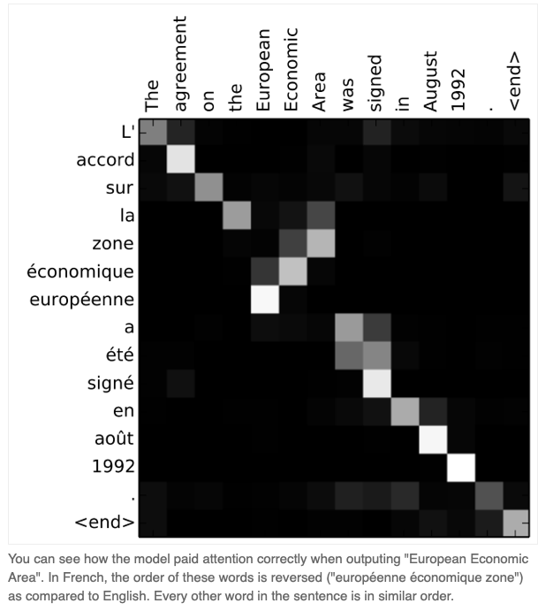
Note that the model isn’t just mindless aligning the first word at the output with the first word from the input.
It actually learned from the training phase how to align words in that language pair (French and English in our example).
https://jalammar.github.io/visualizing-neural-machine-translation-mechanics-of-seq2seq-models-with-attention/

Slide 34
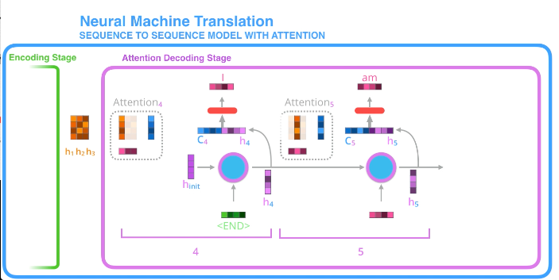
Let us now bring the whole thing together in the following visualization and look at how the attention process works:
The attention decoder RNN takes in the embedding of the <END> token, and an initial decoder hidden state.
The RNN processes its inputs, producing an output and a new hidden state vector (h4). The output is discarded.
Attention Step: We use the encoder hidden states and the h4 vector to calculate a context vector (C4) for this time step.
We concatenate h4 and C4 into one vector.
We pass this vector through a feedforward neural network (one trained jointly with the model).
The output of the feedforward neural networks indicates the output word of this time step.
Repeat for the next time steps
https://jalammar.github.io/visualizing-neural-machine-translation-mechanics-of-seq2seq-models-with-attention/

Slide 35
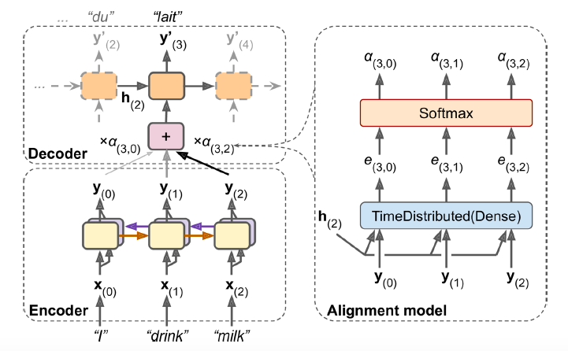
Attention Mechanisms
For example, at the time step where the decoder needs to output the word “lait,” it will focus its attention on the word “milk.” This means that the path from an input word to its translation is now much shorter, so the short-term memory limitations of RNNs have much less impact.
Attention mechanisms revolutionized neural machine translation (and NLP in general), allowing a significant improvement in the state of the art, especially for long sentences (over 30 words)

Slide 36
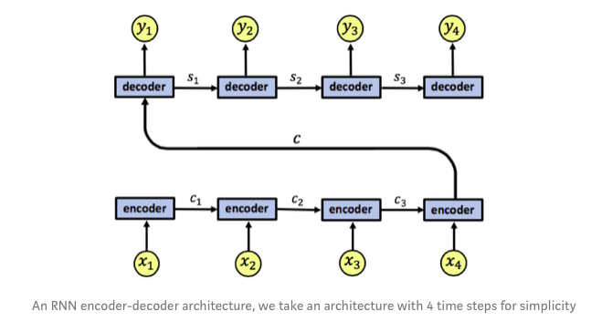
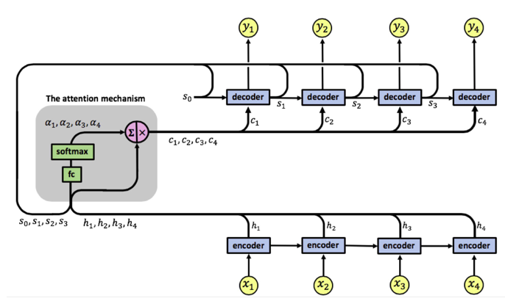
RNN with Attention
Our attention model has a single layer RNN encoder with 4-time steps. We denote the encoder’s input vectors by x1, x2, x3, x4 and the output vectors by h1, h2, h3, h4.
The attention mechanism is located between the encoder and the decoder, its input is composed of the encoder’s output vectors h1, h2, h3, h4 and the states of the decoder s0, s1, s2, s3, the attention’s output is a sequence of vectors called context vectors denoted by c1, c2, c3, c4.
s, h hidden states c context vector

Slide 37
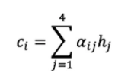
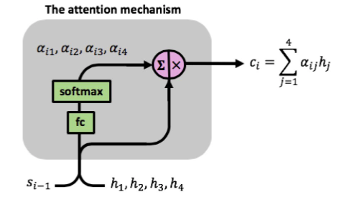
The context vectors?!?
The context vectors enable the decoder to focus on certain parts of the input when predicting its output. Each context vector is a weighted sum of the encoder’s output vectors h1, h2, h3, h4, each vector hi contains information about the whole input sequence (since it has access to the encoder states during its computation) with a strong focus on the parts surrounding the i-th vector of the input sequence. The vectors h1, h2, h3, h4 are scaled by weights ɑij capturing the degree of relevance of input xj to output at time i, yi.
The context vectors c1, c2, c3, c4 are given by:
The attention weights are learned using the attention fully-connected network and a softmax function:

Slide 38
Now what??
Picture this – you’re working on a really cool data science project and have applied the latest state-of-the-art library to get a pretty good result. And boom! A few days later, there’s a new state-of-the-art framework in town that has the potential to further improve your model.
That is not a hypothetical scenario – it’s the reality (and thrill) of working in the field of NLP!
The last two years have been mind-blowing in terms of breakthroughs. We get to grips with one framework and another one, potentially even better, comes along.

Slide 39
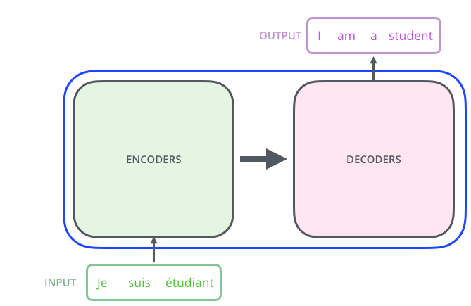
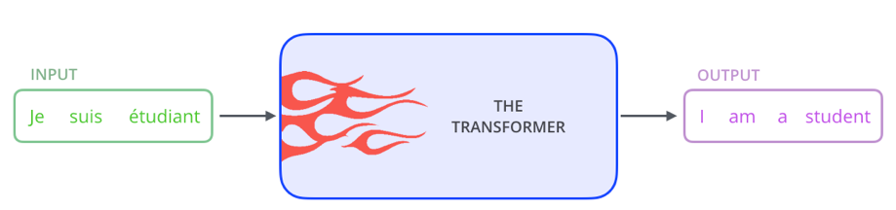
Transformers
The Transformer – a model that uses attention to boost the speed with which these models can be trained.
The Transformer was proposed in the paper Attention is All You Need
It significantly improved the state of the art in NMT without using any recurrent or convolutional layers, just attention mechanisms (plus embedding layers, dense layers, normalization layers, and a few other bits and pieces).
It is much faster to train and easier to parallelize, so they managed to train it at a fraction of the time and cost of the previous state-of-the-art models.
https://jalammar.github.io/illustrated-transformer/

Slide 40
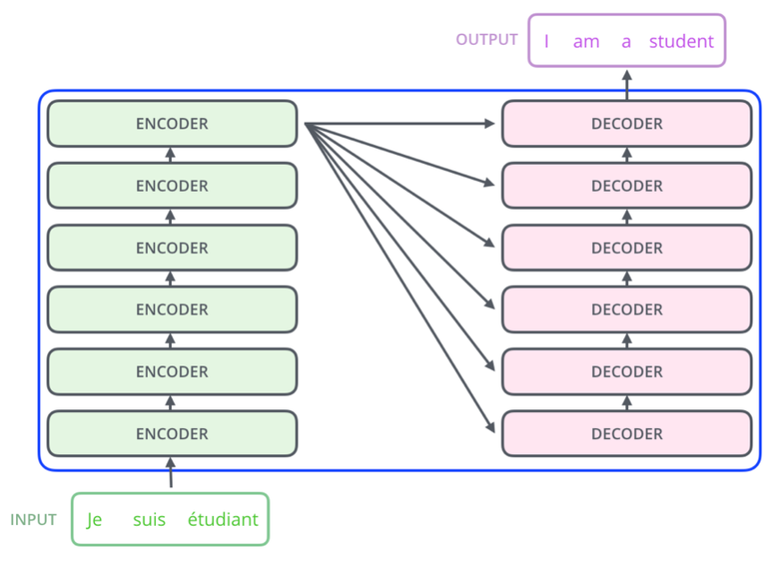
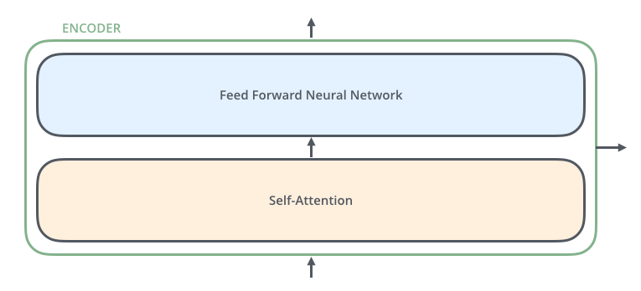
The encoding component is a stack of encoders (the paper stacks six of them on top of each other – there’s nothing magical about the number six, one can definitely experiment with other arrangements).
The decoding component is a stack of decoders of the same number.
The encoders are all identical in structure (yet they do not share weights). Each one is broken down into two sub-layers:
https://jalammar.github.io/illustrated-transformer/

Slide 41
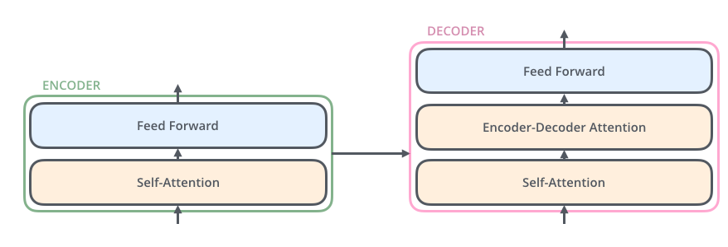
The encoder’s inputs first flow through a self-attention layer – a layer that helps the encoder look at other words in the input sentence as it encodes a specific word.
The outputs of the self-attention layer are fed to a feed-forward neural network. The exact same feed-forward network is independently applied to each position.
The decoder has both those layers, but between them is an attention layer that helps the decoder focus on relevant parts of the input sentence
https://jalammar.github.io/illustrated-transformer/

Slide 42
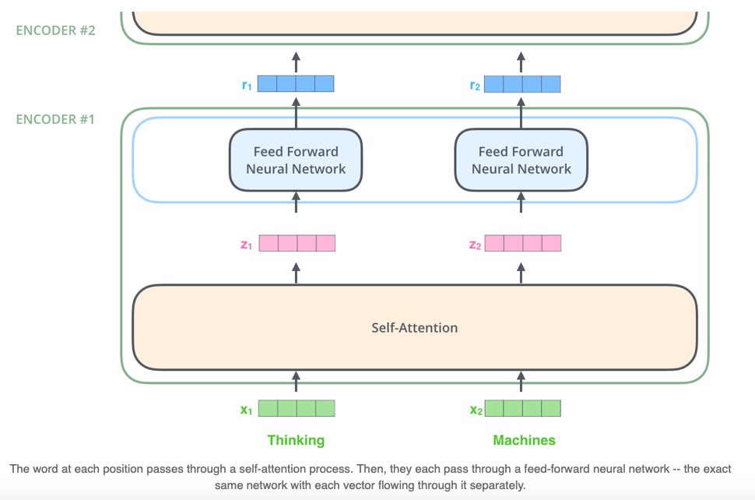
Encoder
After embedding the words in our input sequence, each of them flows through each of the two layers of the encoder.
The word in each position flows through its own path in the encoder.
There are dependencies between these paths in the self-attention layer. The feed-forward layer does not have those dependencies, however, and thus the various paths can be executed in parallel while flowing through the feed-forward layer.
https://jalammar.github.io/illustrated-transformer/

Slide 43

Self-Attention Attention is All You Need paper
we want to translate:
”The animal didn't cross the street because it was too tired”
What does “it” in this sentence refer to? Is it referring to the street or to the animal?
When the model is processing the word “it”, self-attention allows it to associate “it” with “animal”.
As the model processes each word (each position in the input sequence), self attention allows it to look at other positions in the input sequence for clues that can help lead to a better encoding for this word.
https://jalammar.github.io/illustrated-transformer/

Slide 44
Multi-HeadED attention
The paper further refined the self-attention layer by adding a mechanism called “multi-headed” attention. This improves the performance of the attention layer in two ways:
It expands the model’s ability to focus on different positions.
It gives the attention layer multiple “representation subspaces”.
If we do the same self-attention just eight different times with different weight matrices, we end up with eight different matrices
The feed-forward layer is not expecting eight matrices. We concat the matrices then multiple them by an additional weights matrix.
https://jalammar.github.io/illustrated-transformer/

Slide 45


Slide 46

We need to account for the order of the words in the input sequence.
To address this, the transformer adds a vector to each input embedding

Slide 47

https://jalammar.github.io/illustrated-transformer/

Slide 48

Transformer

Slide 49

Welcome to NLP ☺

Slide 50






Slide 51
BERT
BERT : Bidirectional Encoder Representations from Transformers
published by researchers at Google AI Language
It is designed to pre-train deep bidirectional representations from unlabeled text by jointly conditioning on both left and right context. As a result, the pre-trained BERT model can be fine-tuned with just one additional output layer to create state-of-the-art models for a wide range of NLP tasks
is applying the bidirectional training of Transformer, a popular attention model, to language modelling
BERT is pre-trained on a large corpus of unlabelled text including the entire Wikipedia(that’s 2,500 million words!) and Book Corpus (800 million words).
researchers have repeatedly shown the value of transfer learning — pre-training a neural network model on a known task and then performing fine-tuning — using the trained neural network as the basis of a new purpose-specific model.

Slide 52

Bert: Bidirectional and fin-tune
BERT is a “deeply bidirectional” model. Bidirectional means that BERT learns information from both the left and the right side of a token’s context during the training phase.
The most impressive aspect of BERT: We can fine-tune it by adding just a couple of additional output layers to create state-of-the-art models for a variety of NLP tasks.

Slide 53


What do we need to know about BERT?
OpenAI GPT essentially replaced the LSTM-based architecture for Language Modeling with a Transformer-based architecture.
The GPT model could be fine-tuned to multiple NLP tasks beyond document classification, such as common sense reasoning, semantic similarity, and reading comprehension.
GPT also emphasized the importance of the Transformer framework, which has a simpler architecture and can train faster than an LSTM-based model. It is also able to learn complex patterns in the data by using the Attention mechanism.
And this is how Transformer inspired BERT and all the following breakthroughs in NLP.

Slide 54
Differences | BERT | Transformer
Input form | Combination of three steps: 1) Token 2) Segment 3) Position | Combination of two steps: Embedding values Positional encoding
# of layers | 12 or 24 encoder | 6 encoder 6 decoder
# of heads | 12 or 16 | 8
# of dimensions | 768 or 1024 | 512
Additional steps | Pre-trained and fine-tuned steps | No need them

Slide 55
How BERT works?
BERT makes use of Transformer, an attention mechanism that learns contextual relations between words (or sub-words) in a text.
In its vanilla form, Transformer includes two separate mechanisms — an encoder that reads the text input and a decoder that produces a prediction for the task.
Since BERT’s goal is to generate a language model, only the encoder mechanism is necessary.
As opposed to directional models, which read the text input sequentially (left-to-right or right-to-left), the Transformer encoder reads the entire sequence of words at once. Therefore it is considered bidirectional, though it would be more accurate to say that it’s non-directional. This characteristic allows the model to learn the context of a word based on all of its surroundings (left and right of the word).

Slide 56

BERT’s Architecture
all of these Transformer layers are Encoder-only blocks.
With the Transformer encoder, the input is a sequence of tokens, which are first embedded into vectors and then processed in the neural network. The output is a sequence of vectors of size H, in which each vector corresponds to an input token with the same index.

Slide 57

Text Preprocessing
For a given token, its input representation is constructed by summing the corresponding token, segment, and position embeddings.
Token embeddings: A [CLS] token is added to the input word tokens at the beginning of the first sentence and a [SEP] token is inserted at the end of each sentence.
Segment embeddings: A marker indicating Sentence A or Sentence B is added to each token. This allows the encoder to distinguish between sentences.
Positional embeddings: A positional embedding is added to each token to indicate its position in the sentence.

Slide 58

BERT greatly improves upon both GPT and ELMo. Look at the below image
The arrows indicate the information flow from one layer to the next. The green boxes at the top indicate the final contextualized representation of each input word.
It’s evident from the above image: BERT is bi-directional, GPT is unidirectional (information flows only from left-to-right), and ELMO is shallowly bidirectional.

Slide 59
BERT is pre-trained on two NLP tasks: - Masked Language Modeling - Next Sentence Prediction
BERT uses two training strategies:
1- Masked LM (MLM)
Before feeding word sequences into BERT, 15% of the words in each sequence are replaced with a [MASK] token. The model then attempts to predict the original value of the masked words, based on the context provided by the other, non-masked, words in the sequence. In technical terms, the prediction of the output words requires:
Adding a classification layer on top of the encoder output.
Multiplying the output vectors by the embedding matrix, transforming them into the vocabulary dimension.
Calculating the probability of each word in the vocabulary with softmax.
2- Next Sentence Prediction (NSP)
The task is simple. Given two sentences – A and B, is B the actual next sentence that comes after A in the corpus, or just a random sentence?

Slide 60


MLM NSP

Slide 61
How to use BERT (Fine-tuning)
Using BERT for a specific task is relatively straightforward:
BERT can be used for a wide variety of language tasks, while only adding a small layer to the core model:
Classification tasks such as sentiment analysis are done similarly to Next Sentence classification, by adding a classification layer on top of the Transformer output for the [CLS] token.
In Question Answering tasks (e.g. SQuAD v1.1), the software receives a question regarding a text sequence and is required to mark the answer in the sequence. Using BERT, a Q&A model can be trained by learning two extra vectors that mark the beginning and the end of the answer.
In Named Entity Recognition (NER), the software receives a text sequence and is required to mark the various types of entities (Person, Organization, Date, etc) that appear in the text. Using BERT, a NER model can be trained by feeding the output vector of each token into a classification layer that predicts the NER label.

Slide 62
Installing BERT-As-Service
This link can help you with BERT
https://github.com/hanxiao/bert-as-service
https://www.analyticsvidhya.com/blog/2019/09/demystifying-bert-groundbreaking-nlp-framework/
BERT-As-Service works in a simple way. It creates a BERT server which we can access using the Python code in our notebook. Every time we send it a sentence as a list, it will send the embeddings for all the sentences.
We can install the server and client via pip. They can be installed separately or even on different machines:
Also, since running BERT is a GPU intensive task, I’d suggest installing the bert-serving-server on a cloud-based GPU or some other machine that has high compute capacity.

Slide 63

Problem Statement: Classifying Hate Speech on Twitter
We will use BERT to extract embeddings from each tweet in the dataset and then use these embeddings to train a text classification model.
https://www.analyticsvidhya.com/blog/2019/09/demystifying-bert-groundbreaking-nlp-framework/

Slide 64
What’s next?
Many of these projects outperformed BERT on multiple NLP tasks. Some of the most interesting developments were RoBERTa, which was Facebook AI’s improvement over BERT and DistilBERT, which is a compact and faster version of BERT.
Introduced at Facebook, Robustly optimized BERT approach RoBERTa, is a retraining of BERT with improved training methodology, 1000% more data and compute power.
You can read more about these amazing developments regarding State-of-the-Art NLP in this article.
https://www.analyticsvidhya.com/blog/2019/08/complete-list-important-frameworks-nlp/?utm_source=blog&utm_medium=demystifying-bert-groundbreaking-nlp-framework

Slide 65

Which one to use?
Importantly, RoBERTa uses 160 GB of text for pre-training, including 16GB of Books Corpus and English Wikipedia used in BERT. The additional data included CommonCrawl News dataset (63 million articles, 76 GB), Web text corpus (38 GB) and Stories from Common Crawl (31 GB). This coupled with whopping 1024 V100 Tesla GPU’s running for a day, led to pre-training of RoBERTa.
https://towardsdatascience.com/bert-roberta-distilbert-xlnet-which-one-to-use-3d5ab82ba5f8

